Slide 1


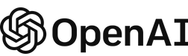








Entra ID
Azure Key Vault
UI App (React.js)
AAD SSO Authentication
Providers API Keys
Azure SWA API “link” to APIM
OpenAI Chat Completions API
Azure API Management
LLM API Gateway
Azure Static Web App
API Request Logs (Technical Metadata Only)
Docker Image in Azure Container App
CI/CD Deploy (Actions Workflow)
Kusto Querying of statistics (per user)
Application Insights
https://github.com/DmitriyAlergant-T1A/BetterChatGPT-t1a

